Slide 1

C# Advanced – Class5
Trainer: Marjan Pushev
Assistant: Dejan Blazheski
Code academy @ Skopje, 2019

Slide 2
Agenda
Generics – Part 1
Delegates
Events
Anonymous methods

Slide 3
Generics
Generics allow you to define a class with placeholders for the type of its fields, methods, parameters, etc. Generics replace these placeholders with some specific type at compile time.
A generic class can be defined using angle brackets <>.
In the next slide MyGenericClass is defined with <T>. <> indicates that MyGenericClass is generic and the underlying type would be defined later, for now consider it as T. You can take any character or word instead of T.

Slide 4
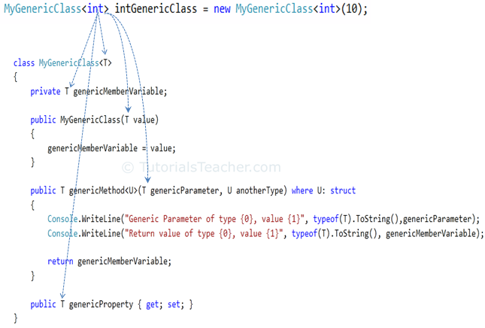

Slide 5
Generics
Demo

Slide 6
Delegates
delegate keyword
Delegate is a type-safe function pointer: it points to a function and when a delegate is called that function will be used.
Delegates offers flexibility:
They have similar structure as functions. The signature of the delegate must match the signature of the function it calls, otherwise you get a compiling error.
Delegate is similar to class in the way that you can make an instance of it and then call functions.
Multi-cast delegate: is a delegate that has references to multiple functions. In this case a single call of the delegate calls each of the added functions to the delegate.
Declaration: A delegate can be declared “anywhere”: outside the namespace, inside the namespace, inside a class or nested class. It’s scope/visibility depends on the place where it’s defined.

Slide 7
Delegates
Demo 1
Demo 2

Slide 8
Events
Events are variables of type delegates
Events enable a class or object to notify other classes or objects when something of interest occurs. The class that sends (or raises) the event is called the publisher and the classes that receive (or handle) the event are called subscribers.
In .NET, events are based on the EventHandler delegate and the EventArgs base class.

Slide 9
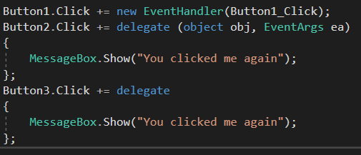
Anonymous Methods
Anonymous Method is a method without a name.
They provide a way of creating a delegate without having to write separate method.

Slide 10
Events and Anonymous Methods
Demo: Windows Forms simple application. Open the Form1_Load() method of the form and see the code there. See the three different calls for delegates.

Slide 11
List of some events
Click – e.g. on Button click
Load – e.g. on Form load
DoubleClick – e.g. on double click on a control
TextChanged – when the text of a control changes
MouseClick
MoseDoubleClick
MouseHover
…
KeyPressed
KeyDown
KeyUp
…
Scroll
DragDrop
DragEnter
DragLeave
DragOver
…

